Slide 1
Application Hot Patcher
Madhusudanan Kandasamy
Vidya R
Lakshmanan Velusamy
Rajbir Bhattacharjee

Slide 2
Background
Whenever a bug is found for an application, a patch is shipped.
Often a patch consists of new version of the application binary which consists of the changes to just one/few functions/
To apply the patch, the running application must be killed or terminated before the patch can come into effect.
After application of the patch, the the application has to be restarted
Often, restarting the application takes a lot of time and it leads to a downtime and hence business loss. In addition the intermediate data computation is also lost.

Slide 3
HOT PATCHING
Background
It would be nice, if it were possible to replace the code of a function in a running process without having to terminate the process.
Our project provides a way to replace the buggy function in a process image with a new function without bringing the application down.
It changes the process image of the running process to achieve that.

Slide 4
Function call mechanism
Patched Process
Patching Process
Process
TOC
F() Buggy function
Glink code

Slide 5
Function Call Mechanism
Any call to f() first branches to the glink code
Glink code reads the address of f() from the TOC
Glink code then branches to the read address of f()
The glink and the TOC help in relocation

Slide 6
Mechanism of Patching
Step 1:
  Patching process modifies the patched process by replacing function f with its own code
  The replaced function f(), when called the next time will load the patched function f() from the object file by using dlopen() and dlsym()
  Control will now go back to the patching process

Slide 7
Implementation
Patching Process
Patched Process
Process
TOC
F() Buggy function
Code to load new
Patched f() using dlsym()
Glink code

Slide 8
Implementation
When the function f() in the process is called next time, it calls dlopen and dlsym() to load the patched f() from the object file.
Control then goes over the the patching process
Patching process now modifies the TOC to point to the new f()

Slide 9
Implementation
Patching Process
Patched Process
Process
F() Buggy function
TOC
Code to load new
Patched f() using dlsym()
Glink code
Patched f()
loaded by dlsym()

Slide 10
Implementation
Controlling process gets control. It then patches the TOC to point to the just loaded patched f()

Slide 11
Implementation
Patching Process
Patched Process
F() Buggy function
Process
TOC
TOC modified
To point to new f()
Code to load new
Patched f() using dlsym()
Glink code
Patched f()
loaded by dlsym()

Slide 12
Implementation
Now any further function call to f() will call the glue-code
The glue-code will load the new address of the patched f() from the TOC
Branch will happen to the new f() and achieve the run time modification of the function.

Slide 13
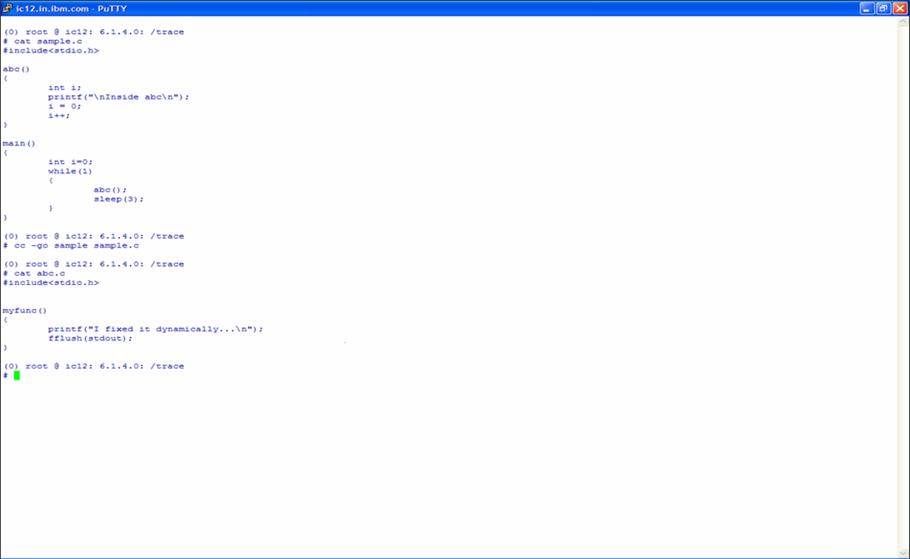
DEMO AND SCREEN SHOTS
Source code of the application (sample.c)
Source code of the patch(abc.c)

Slide 14
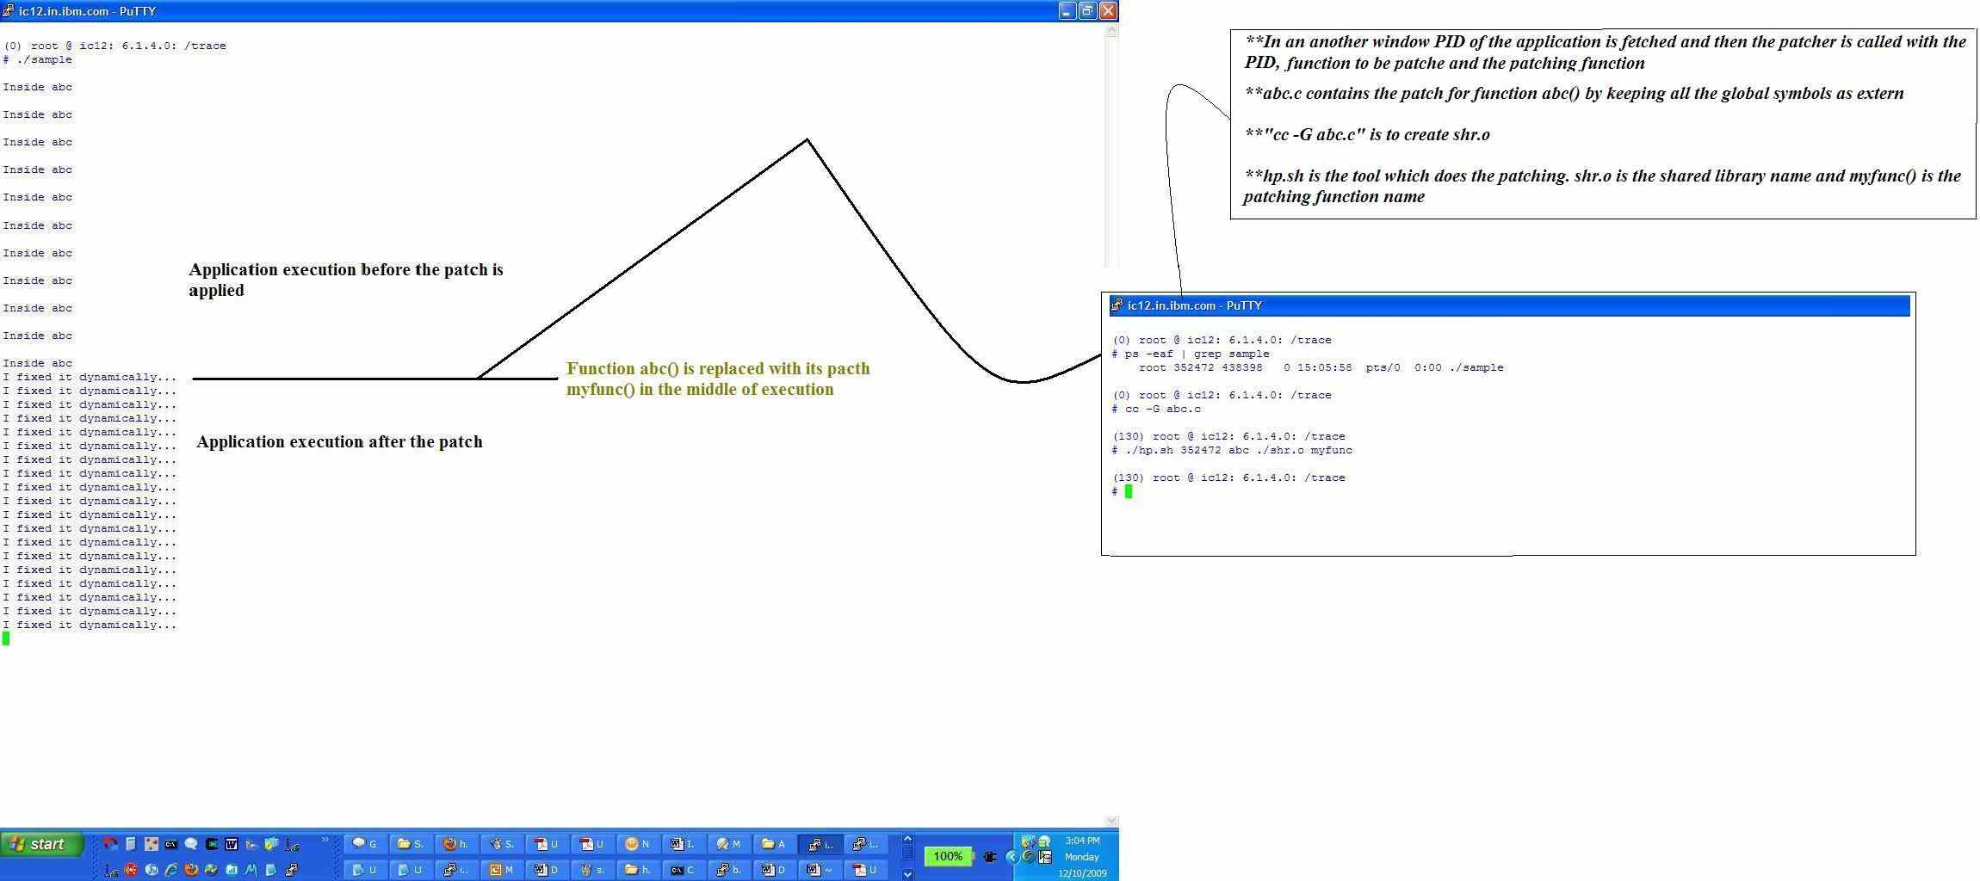
LIVE Patching…

